Slide 1
More HTML and Basic CSS
BDPA Indy SITES
05/16/2020

Slide 2
Text Formatting
<b> Bold text </b>
<i> Italic text </i>
<mark> Highlighted text </mark>
<small> Small </small> text
<del> Strike text </del>
<ins> Underlines text </ins>
<sub> Subscript </sub> text
<sup> Superscript </sup> text
Bold text
Italic text
Highlighted text
Small text
Strike text
Underlined text
_{Subscript} text
^{superscripted} text

Slide 3
List
An unordered list:
Item
Item
Item
An ordered list:
First
Second
Third
<ul> <li>Item</li> <li>Item</li> <li>Item</li> </ul>
<ol> <li>First</li> <li>Second</li> <li>Third</li> </ol>

Slide 4
Table Element
The <table> element uses 3 other elements to format the table:
<th> -table header
<tr> - table row
<td> - table data
By default <th> headers are bold and centered
<table> <tr> <th>First Name</th> <th>Last Name</th> <th>Age</th> </tr> <tr> <td>John</td> <td>Smith</td> <td>50</td> </tr> <tr> <td>Eva</td> <td>James</td> <td>43</td> </tr> </table>
First Name | Last Name | Age
John | Smith | 50
Eva | James | 43

Slide 5

Image Element
The <img> element allows you to embed images in a html page
Images have 4 common attributes:
src: the file path or URL of the image location
alt: text shown if the image does not load
width: set width of the image
height: set height of the image
Be careful with image ratios
It is best practice to set the alt text
for those with slow connections, the
the blind community, and src errors
<img src=“www. stockpics.com/sample.jpeg" alt=“tree" width=“600" height=“300">

Slide 6
File Paths
The src attribute can also hold a file path
Create a coherent system of folders for your assets
A valid file path must have a file extension and forward slashes separating folders
Path | Description
<img src="picture.jpg"> | Located in the same folder as the current page
<img src="images/picture.jpg"> | Located in the images folder in the current folder
<img src="/images/picture.jpg"> | Located in the images folder at the root of the current web
<img src="../picture.jpg"> | Located in the folder one level up from the current folder

Slide 7
Iframe Element
The <iframe> element displays a web page within a web page
The <iframe> element has similar attributes to the <image> element
The src(source) attribute is the file location of a html file or an URL to an external website
<iframe src="demo.htm" height=“600" width=“1000"></iframe>
https://www.w3schools.com/htmL/html_iframe.asp

Slide 8
Block Elements
Every HTML element has a default display value, depending on what type of element it is.
A block-level element always starts on a new line and takes up the full width available
The <div> element is often used as a container for other HTML elements.
<div style="background-color:black; color:white;"> <h2>London</h2> <p>London is the capital city of England.</p> </div>
<li> | <p> | <ul> | <table>
<header> | <div> | <pre> | <footer>

Slide 9
Inline Elements
An inline element does not start on a new line and only takes up as much width as necessary.
The <span> element is an inline container for text
<p>This is <span style="border: 1px solid black"> an inline span element</span> inside a paragraph.</p>
This is an inline span element inside a paragraph.
More on border: https://www.w3schools.com/css/css_border.asp

Slide 10

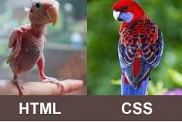
What is CSS?
Cascading Style Sheets
Can change the layout of multiple web pages
Takes it from basic to fabulous
Current version: CSS3

Slide 11
Types of CSS
Inline CSS
Internal CSS
External CSS

Slide 12
Inline CSS
Use the style attribute in HTML elements
Only edits the one element
Multiple properties can be added to one style separed by semicolon
<h1 style="color:red;">This is a Red Heading</h1>
This is a Red Heading

Slide 13
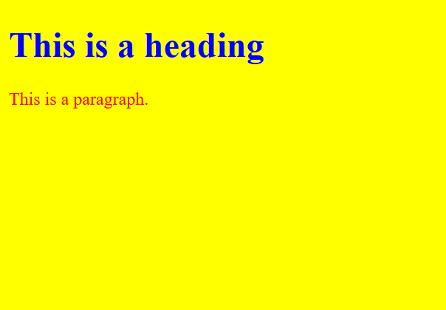
Internal CSS
Placed in the <head> element of a document
Defines a style for the entire HTML document
<!DOCTYPE html> <html>
<head>
<style> body {background-color : yellow;}
h1 {color: blue;}
p {color: red;} </style>
</head>
<body>
<h1>This is a heading</h1>
< p> Here is a sentence</p>
</body>
<html>

Slide 14
External CSS
A separate CSS file that is linked to an HTML page
Used the <link> element to reference an external style sheet
The <link> element has two common attributes:
rel: the relationship between the two documents
href: Hypertext REFerence
<!DOCTYPE html> <html> <head> <link rel="stylesheet“ href="styles.css"> </head> <body> <h1>This is a heading</h1> </body> </html>

Slide 15
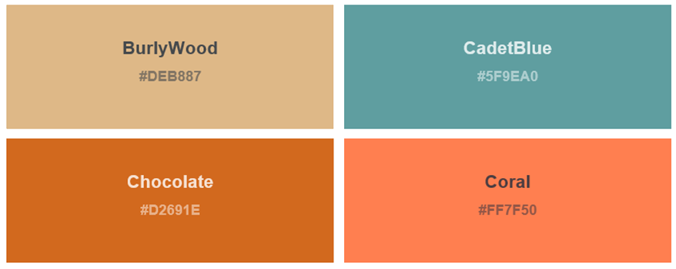
HTML Colors
There are 140 predefined colors
Define custom colors using RGB and hex values
<h1 style="background-color:rgb(255, 99, 71);">...</h1> <h1 style="background-color:#ff6347;">...</h1>
https://www.w3schools.com/tags/ref_colornames.asp
https://www.w3schools.com/colors/default.asp

Slide 16
Altering Text Fonts
Elements using text can use the following attributes:
Use color for text colors
Use background-color for background color behind the text
Set font-size for text sizes by pixel or percentage of normal size
Set text-align for text alignment like left, right and center
Use font-family for text fonts like Serif, Times New Roman, ect.
https://www.w3schools.com/cssref/css_websafe_fonts.asp

Slide 17
Style Classes and Ids
Class is a global attribute that can be can be used on any HTML element.
Best when you want to style a subset of elements, especially div elements
<div class="class-name">
You can also style a specific element using the id with a pound key
<div id=“main">
<style> .class-name { background-color: black; color: white; margin: 20px; padding: 20px; }
#main { background-color: black; color: white; margin: 20px; padding: 20px; } </style>

Slide 18


Web Browser Compatibility
Internet Explorer hates change and has the lowest support
Firefox and Chrome will power through and figure it out
Safari mobile freaks out more regularly than Android WebView
While HTML5 is the new “standard” for designing webpages, support varies wildly between common browsers and browser versions
For an all encompassing list of compatibility see the links below:
For HTML: https://www.w3schools.com/tags/ref_html_browsersupport.asp
For CSS: https://www.w3schools.com/cssref/css3_browsersupport.asp

